Slide 1
IMAGE BASED ATTENDANCE MONITORING SYSTEM
Group Number : 23
1.Dhanush M Kuber 1PE12EC041
2.Chethan Kumar TJ 1PE13EC031
3.Bhagyashree 1PE13EC024
4.Mridula C 1PE13EC076
Guide: Dr. Subhash Kulkarni

Slide 2




DESIGN FLOW WITH TIMELINE
Data base building
Literature collection
Pre processing
15/10/16
Face detection
15/12/16
Feature set
Building and
Recognition
1/2/17
Demonstration
And compilation
25/4/17
Android enabled
App building
15/4/17
Integration
and Testing
15/3/17

Slide 3
TASKS PERFORMED TO DATE
Image Detection and Recognition using MATLAB
Detection - Viola and Jones Algorithm
Recognition - Eigen Face using Principle Component
Analysis
Integration of Detection and Recognition modules (MATLAB)
Image Detection using Open CV (Open Source Computer Vision)

Slide 4
DETECTION
Performed using Viola and Jones Algorithm
Group image of 5 subjects
Training Database
8 images of every individual with varying facial orientations

Slide 5
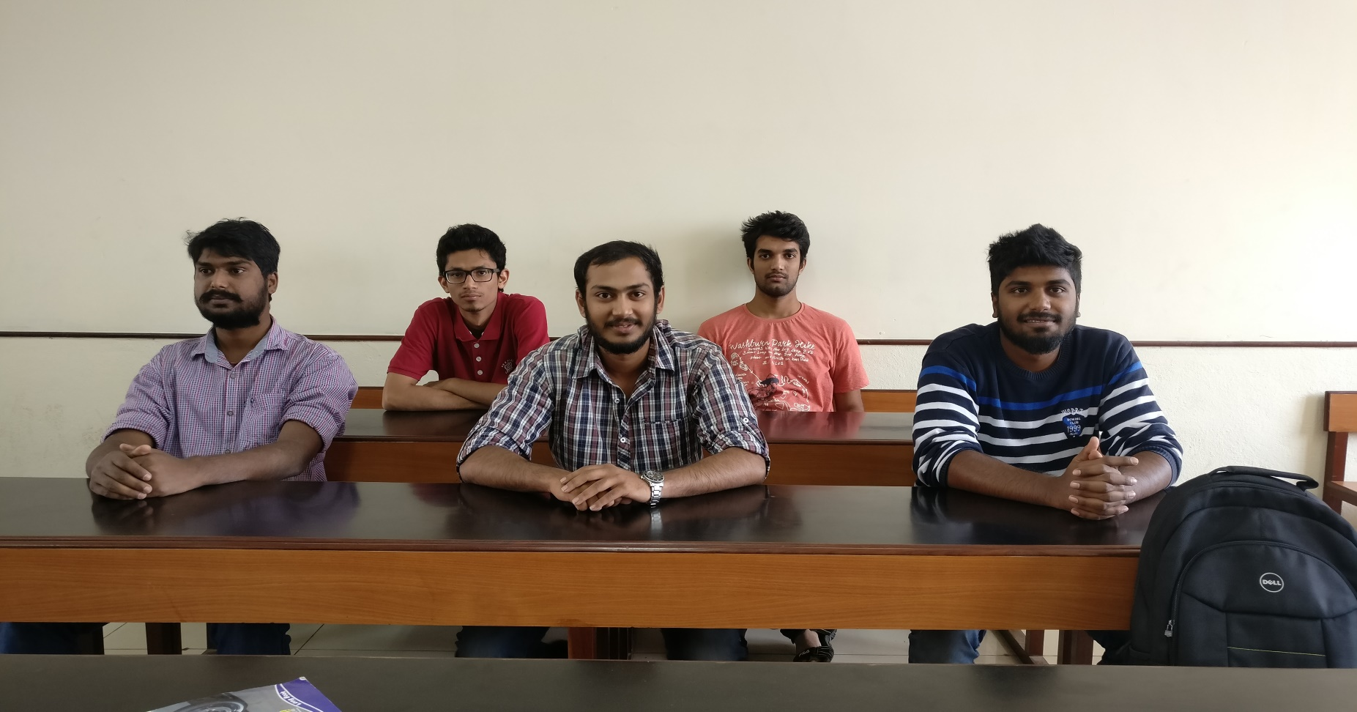
RESULTS
Input Image

Slide 6
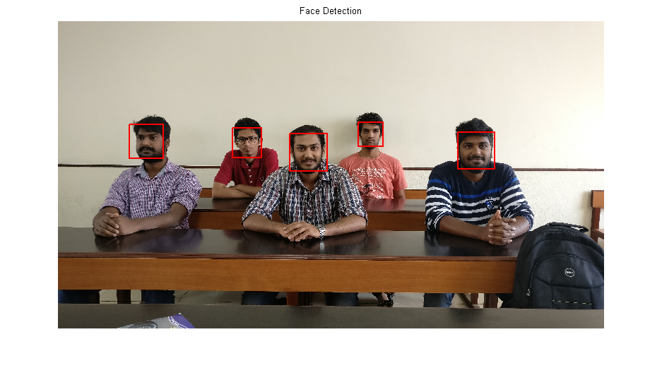
After Detection
After Detection

Slide 7
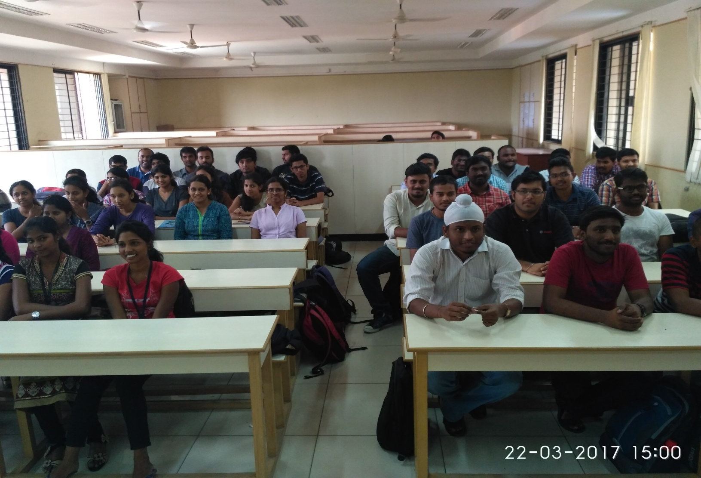
Group image of 35 subjects (Dimensions = 4160×3120)

Slide 8
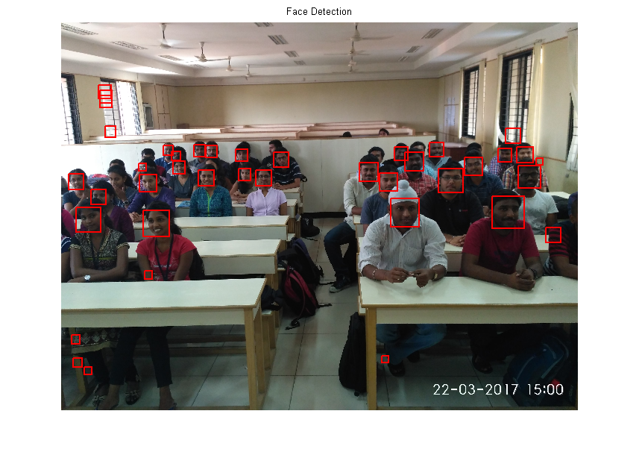
After Detection

Slide 9
Database
Group of 35 subjects
Various angles
5 images of every subject with varying face orientation
Similar conditions

Slide 10
Processing
Background elimination
→ Brightness
→ Image resolution

Slide 11
Forthcoming
Recognition using Open CV
Android based Application development

Slide 12
REFERENCES

